Slide 1
Capstone Project The Battle of Neighborhoods

Slide 2
Business Problem (Aim of the Project)
To start Sushi restaurant in Manhattan, New York with an Intention of serving the best sushi in the entire Manhattan area also to acquire more customer acquisition.
The aim of this project is to find the best location to start the sushi restaurant, the approach to solve the problem is shown in the forthcoming slides

Slide 3
Introduction
New York, also known as the Big Apple, is a city which offers infinite things to do and places to see. To make the most of your holidays, preparing your trip well and a good guide of the city are essential. And City of New York is famous for its excellent cuisine. It's food culture includes an array of international cuisines influenced by the city's immigrant history.
Sushi is perhaps the most famous Japanese food in the world. Sushi is defined as any dish that is made with vinegared sushi rice. Although you can make sushi without using any fish or raw fish, many kinds of seafood are used in sushi dishes.Sushi restaurants have become so popular in the United States now it seems that there is one on every corner, not only in major cities but also in smaller cities. Starting a sushi restaurant can be a great business opportunity, but you need to distinguish yourself from others to enjoy long-term success.

Slide 4
Data
This project is about finding the best location to start a sushi restaurant and get a good amount of user acquisition and given best in class customer experience, we will use the following sources of information:
● New york has a total of 5 boroughs and 306 neighborhoods. In order to segment the neighborhoods and explore them, we will essentially need a dataset that contains the 5 boroughs and the neighborhoods that exist in each borough as well as the latitude and longitude coordinates of each neighborhood. This dataset exists for free on the web, here is the link to the dataset: ​ https://geo.nyu.edu/catalog/nyu_2451_34572
● Sushi category id is extracted from Foursquare Venues Categories - https://developer.foursquare.com/docs/resources/categories | Sushi category Id - 5bae9231bedf3950379f89e4

Slide 5
Methodology
Importing data from New York University
Importing data from Foursquare for sushi restaurant
Creation of Clusters
Analysing Neighbourhood
Conclusion

Slide 6
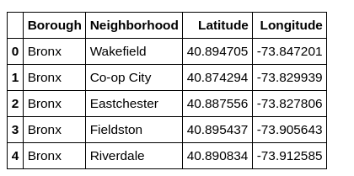
Importing data from NYU Open data
Data from NYU Open data is been imported from https://geo.nyu.edu/catalog/nyu_2451_34572​
Below is the screenshot of the data, it gives 5 boroughs and its neighbourhood with its latitude and longitude.

Slide 7
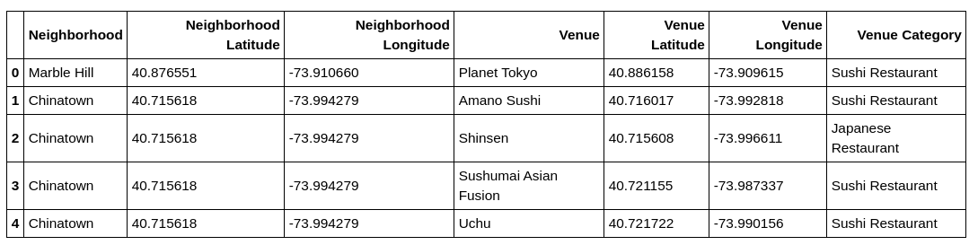
Importing data from Foursquare API
Foursquare API will give all the nearby places and its details this works as same as google maps from New York data we got the neighbourhood latitude and longitude by using this lat long we call Foursquare API which gives the nearby sushi restaurant
Sushi category id - 4bf58dd8d48988d1d2941735 from Foursquare API

Slide 8
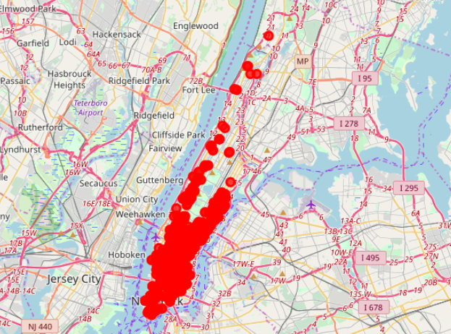
Plotting the data using matplotlib library

Slide 9
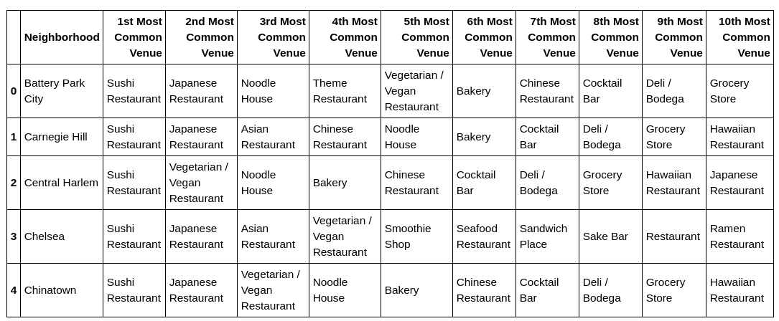
Further the data is processed by using folium library and it is plotted in Manhattan map

Slide 10
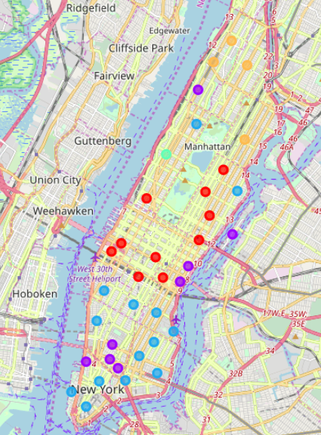
Folium plotted the geospatial data perfectly on the map and it is bifurcated with colour code

Slide 11
K-Means Clustering
There are 5 cluster that are obtained from the data
Cluster 0
Cluster 1
Cluster 2
Cluster 3
Cluster 4

Slide 12
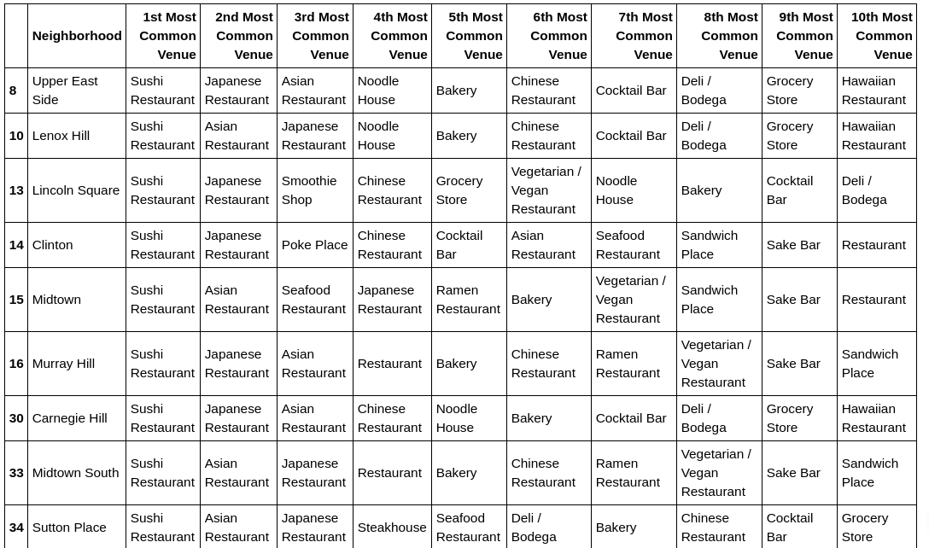
Cluster 0

Slide 13
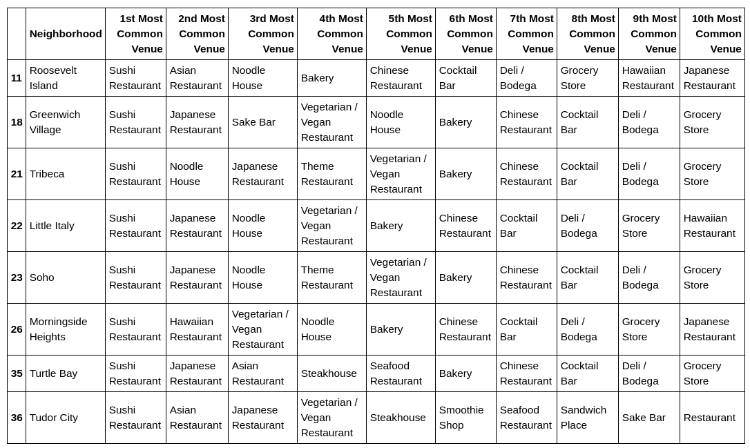
Cluster 1

Slide 14
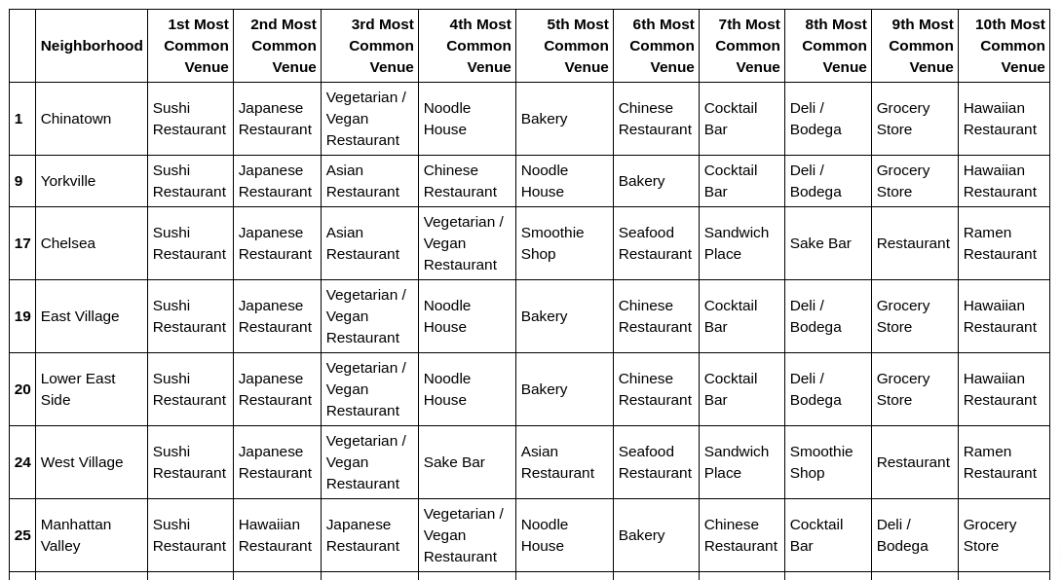
Cluster 2

Slide 15
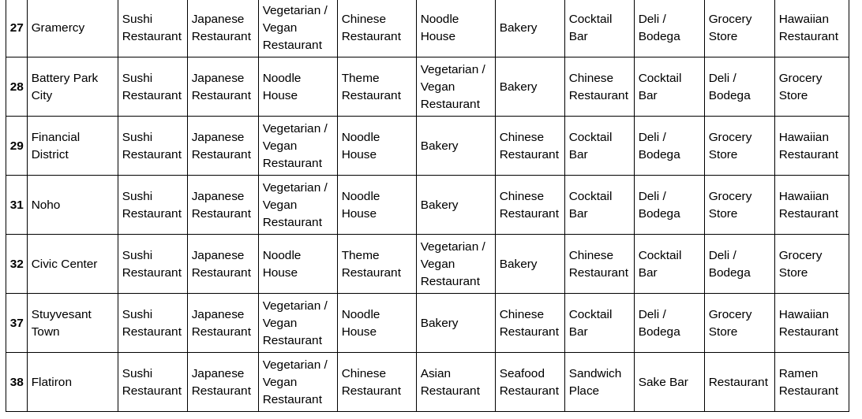
Cluster 2 contin..

Slide 16
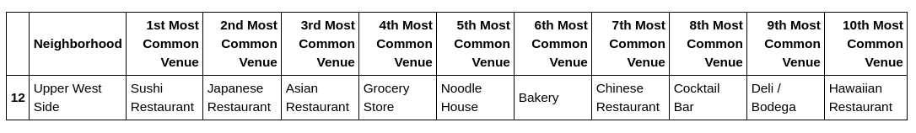
Cluster 3

Slide 17
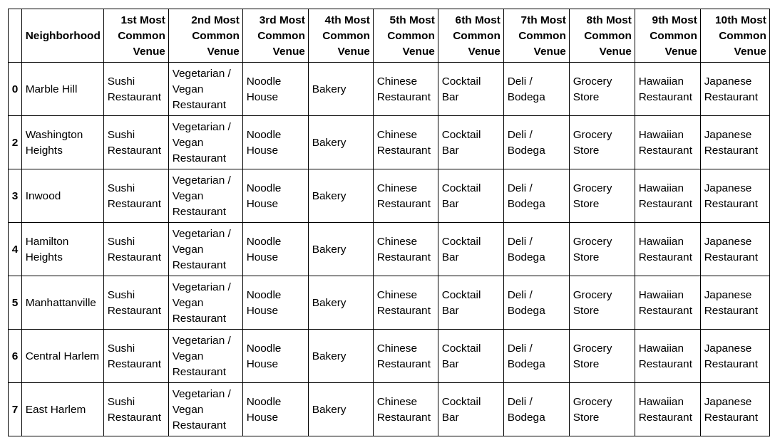
Cluster 4

Slide 18
Result
From the above K-means clustering it can be found that cluster 3 will be the ideal place to start the business and the name of the locality is Upper west side below is the attached screenshot which gives us the clear picture about where sushi restaurant must start.
Cluster 3 data

Slide 19
Conclusion
Although all of the goals of this project were met there is definitely room for further improvement and development as noted below. However, the goals of the project were met and, with some more work, could easily be developed into a fully fledged application that could support the opening a business idea in an unknown location.
As per the neighbourhood or restaurant type mentioned like Sushi restaurants analysis can be checked. A venue with lowest risk and competition can be identified.

Slide 20
Thank You….!

